Slide 1
Introduction
A business requirement is something that the business needs to do or have in order to succeed in business; it is not something a system must do.
These generally are collected from the stakeholders of a program, project or initiative and should relate to a specific need that must be addressed in order to achieve a business objective.
Where appropriate, Business Requirements should be aligned to a business capability.
Business Requirements are contextualized in terms of their expected impacts:
  People – development of knowledge and skills, changes to the organizational structure, cultural programs, changes to roles and responsibilities
  Process – process re-engineering (including consolidation across the value system)
  Information – changes to data governance, data quality and data management practices, data model re-design, etc.
  Technology – new systems development, consolidation of redundant systems, feature enhancement of existing systems

Slide 2
PD 002
Later
People
PD 001
ID | Demand | Focus
001 | People Demand 1 | People
002 | People Demand 2 | People
003 | Process Demand 1 | Process
004 | Process Demand 2 | Process
005 | Information Demand 1 | Information
006 | Information Demand 2 | Information
007 | Information Demand 3 | Information
008 | Technology Demand 1 | Technology
009 | Technology Demand 2 | Technology
ID 007
PD 004
Next
ID 006
TD 009
PD 003
Process
Now
ID 005
Pallet
Demands
Dependencies
Information
People Demand
Process Demand
Information Demand
TD08
Technology Demand
Initiatives are represented by color
Technology

Slide 3
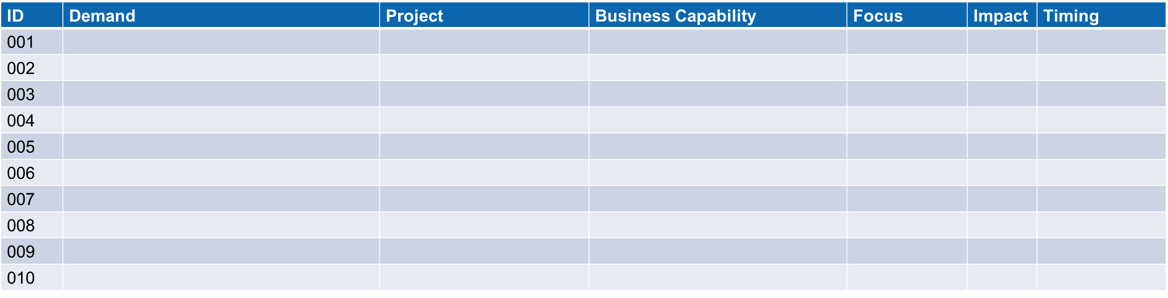
Introduction to Mapping Initiatives to Capabilities
1. Business Capability
Identifying the business capability each initiative supports provides valuable context as to its strategic importance.
5. Demand
Identify the business capability each initiative supports provides valuable context as to its strategic importance.
2. Focus
People, Process, Information, Technology
4. Timing
months
3. Impact
Uplift, New, Retire

Slide 4
Mapping Initiatives to Capabilities
ID | Demand | Project | Business Capability | Focus | Impact | Timing
001
002
003
004
005
006
007
008
009
010

